Slide 1
22/03/24
Hacking >:D

Slide 2

HAK5 – The Father of HACKING DEvices
Creating Hacking devices since 2005

Slide 3

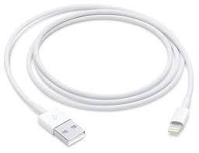



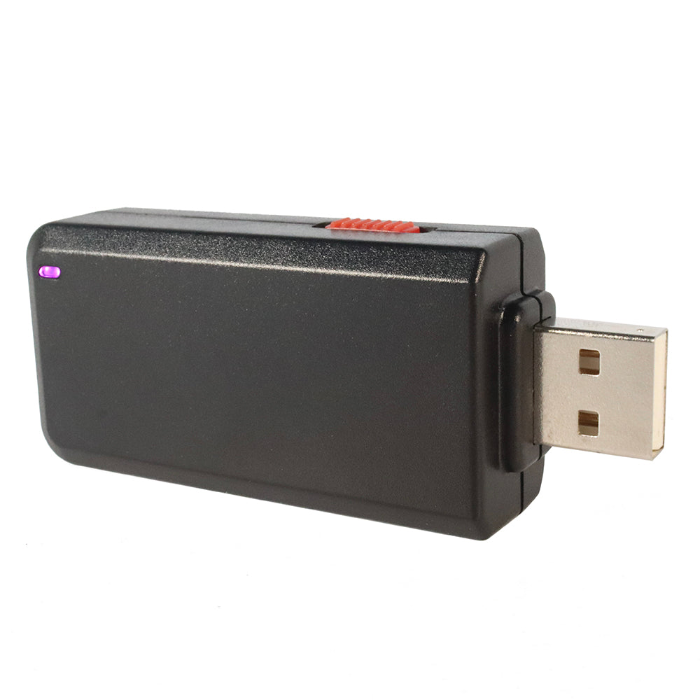
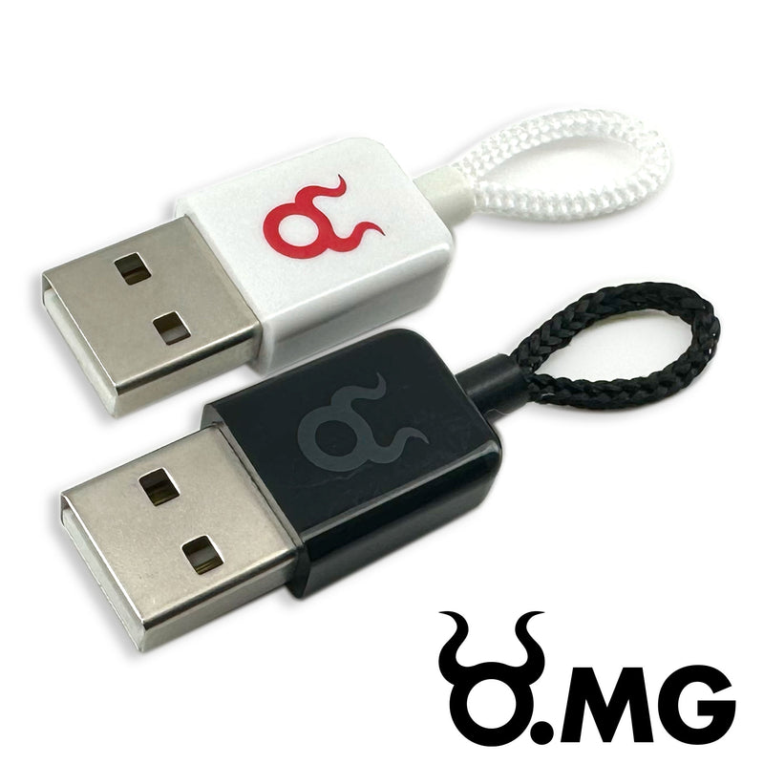
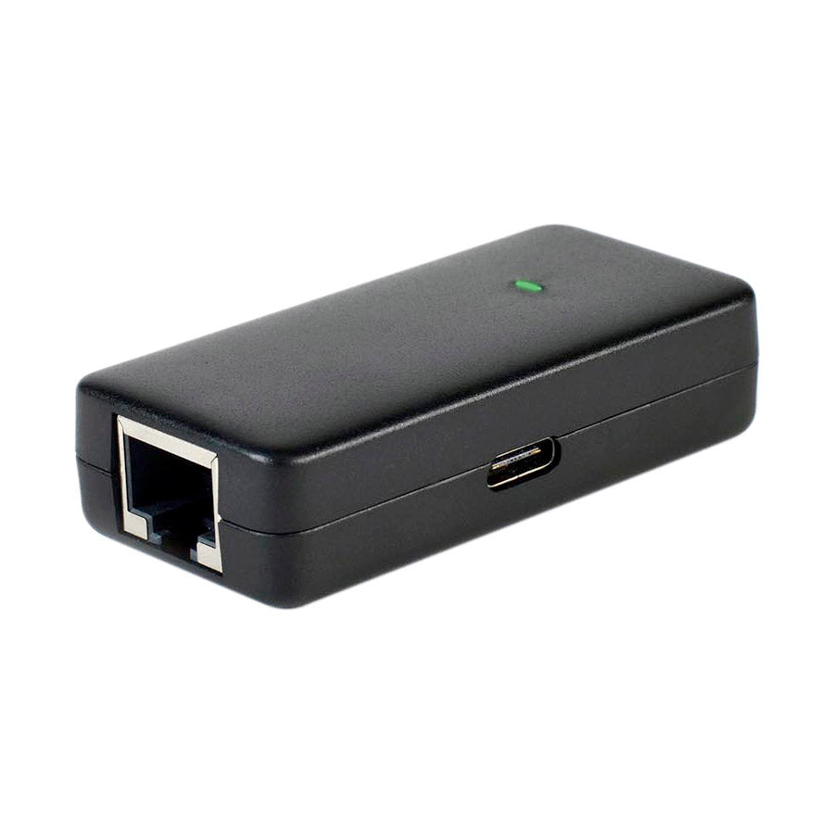
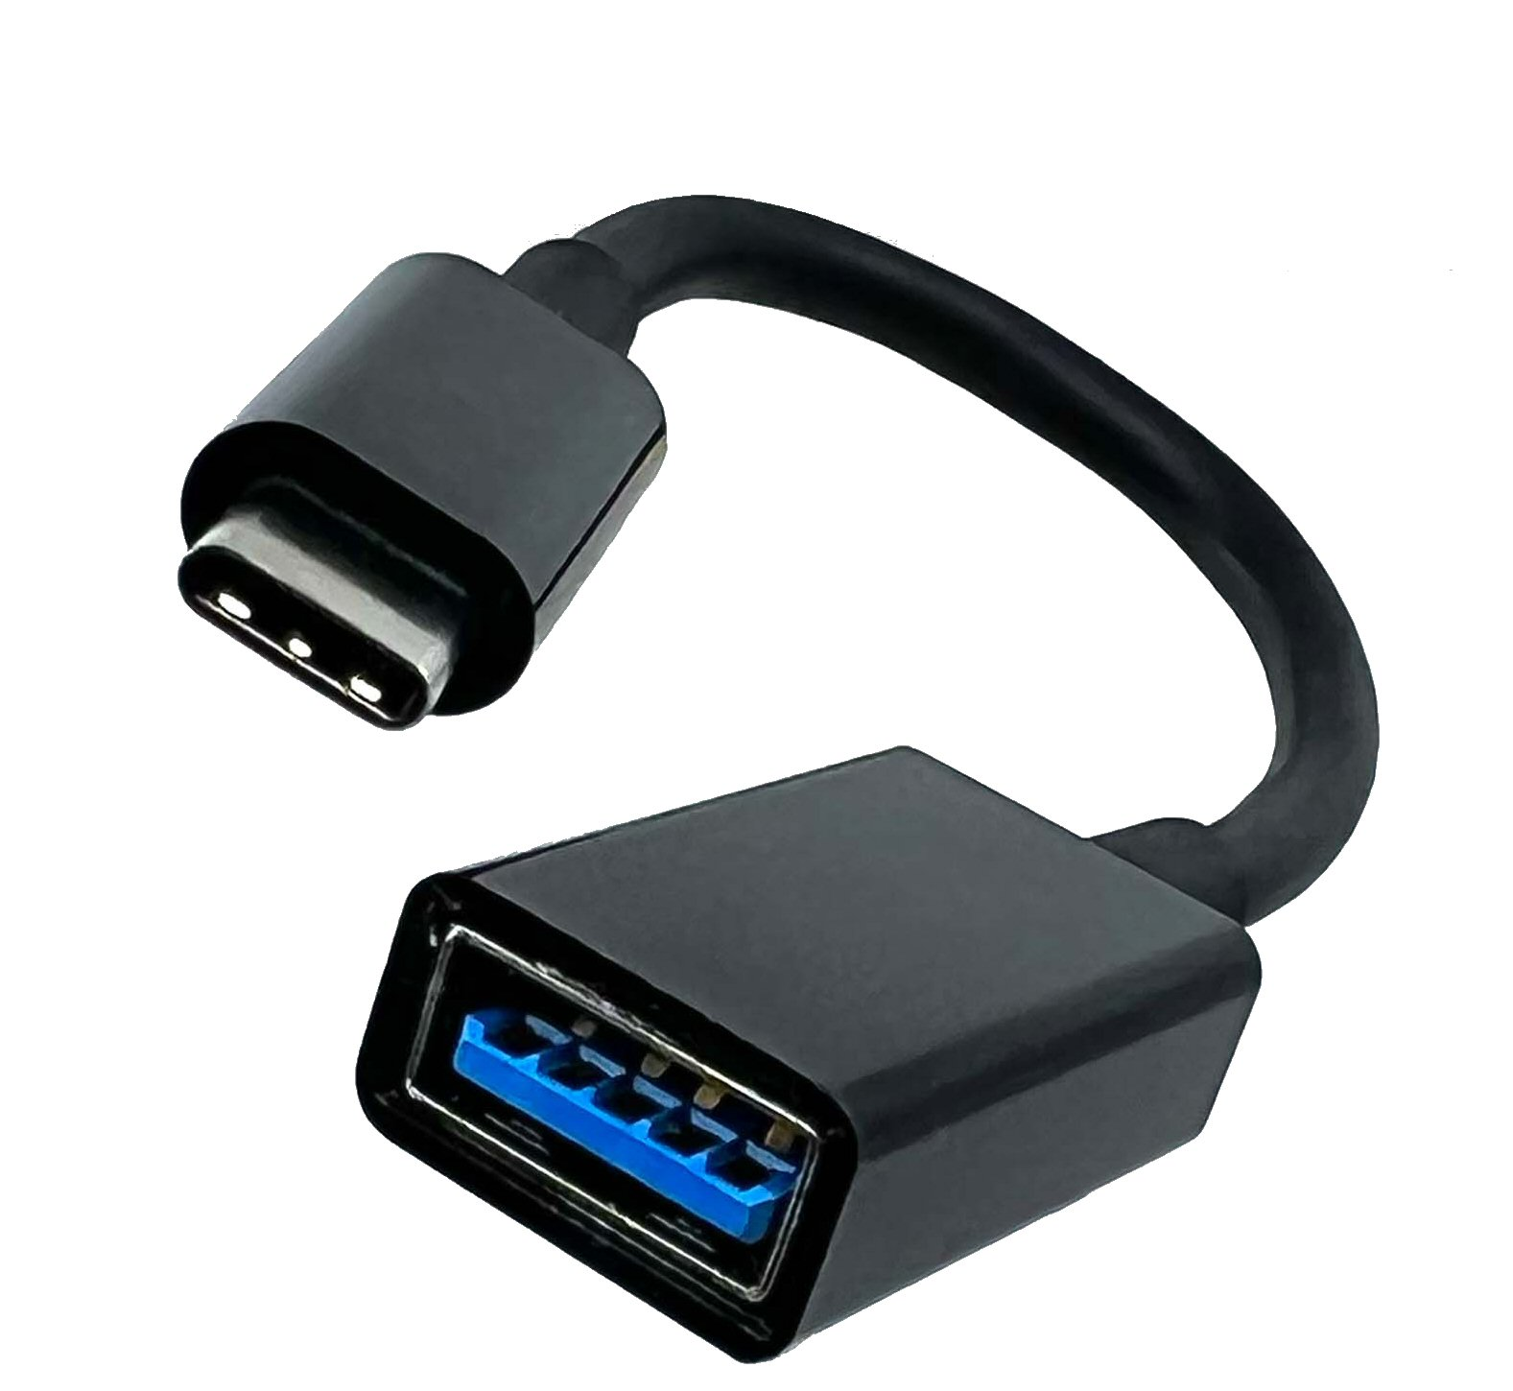
FAVOURITE PRODUCTS/BEstsellers

Slide 4
Ducky Script Example

